Slide 1
“Data Scientists spend up to 80% of the time on data cleaning and 20 percent of their time on actual data analysis”
-- ?????

Slide 2
Todays Learning objectives
Finding your data… How do we do it? Then how do we save it?
Viewing and inspecting your data
What is quarto and it’s functionality

Slide 3
So you want to be a data scientist…

Slide 4
How will you spend your time?

Slide 5
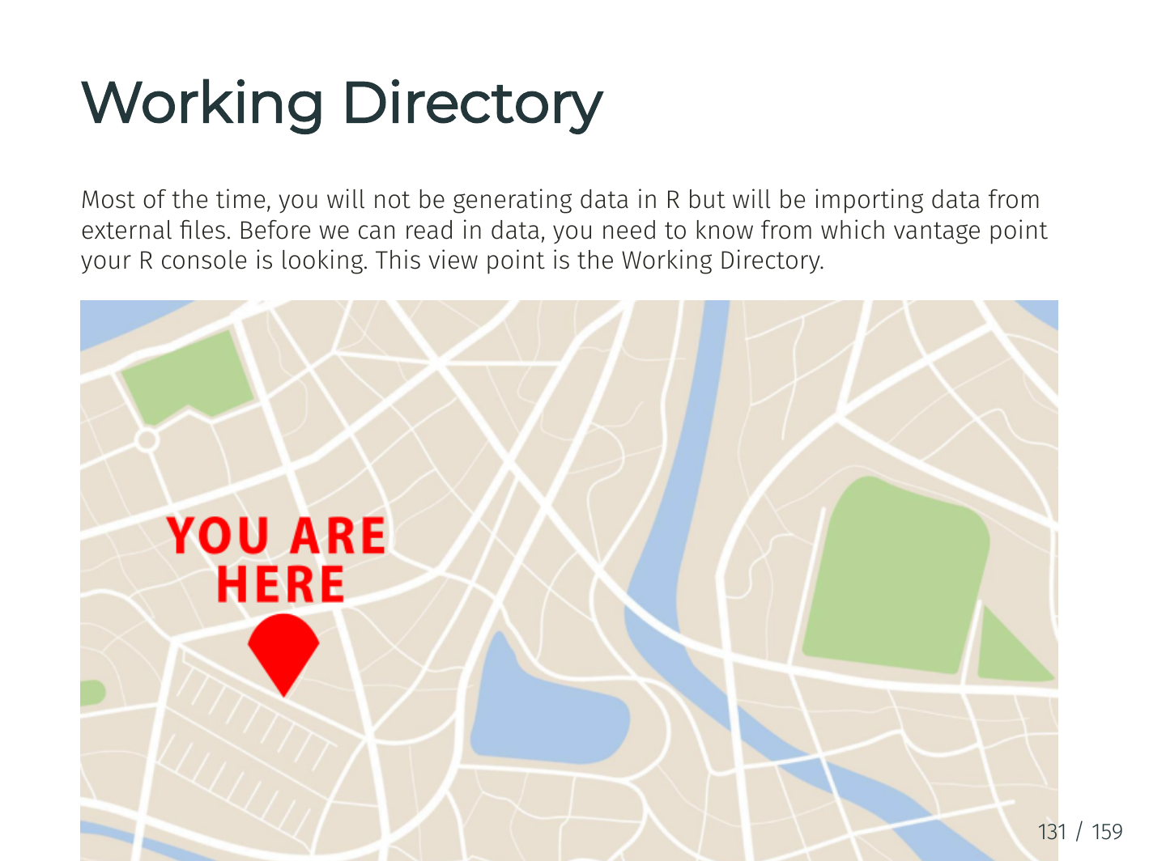

Slide 6
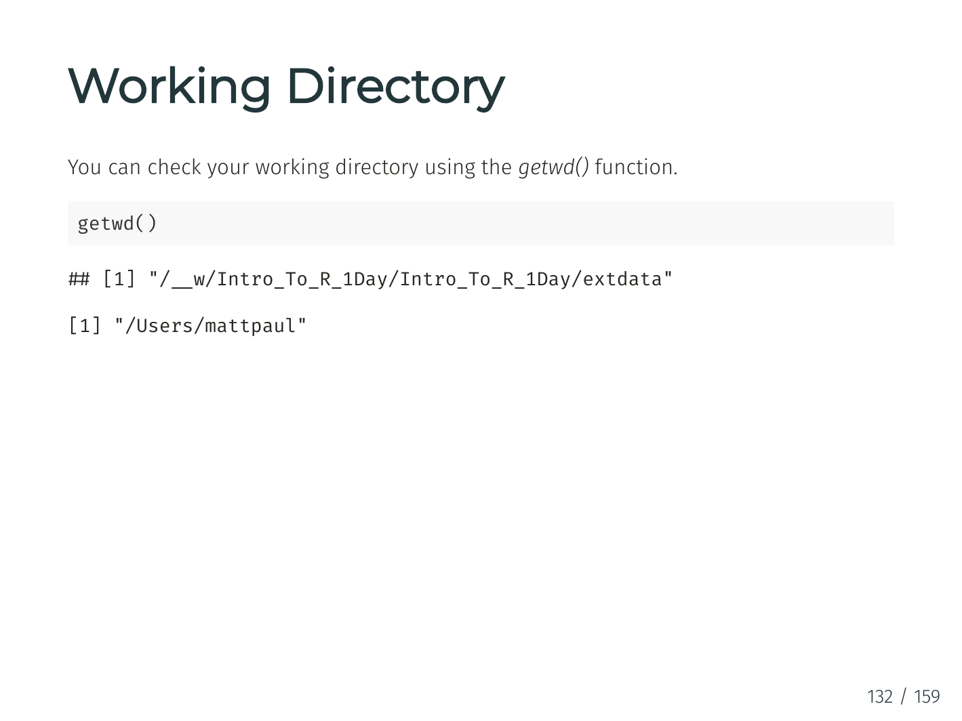

Slide 7
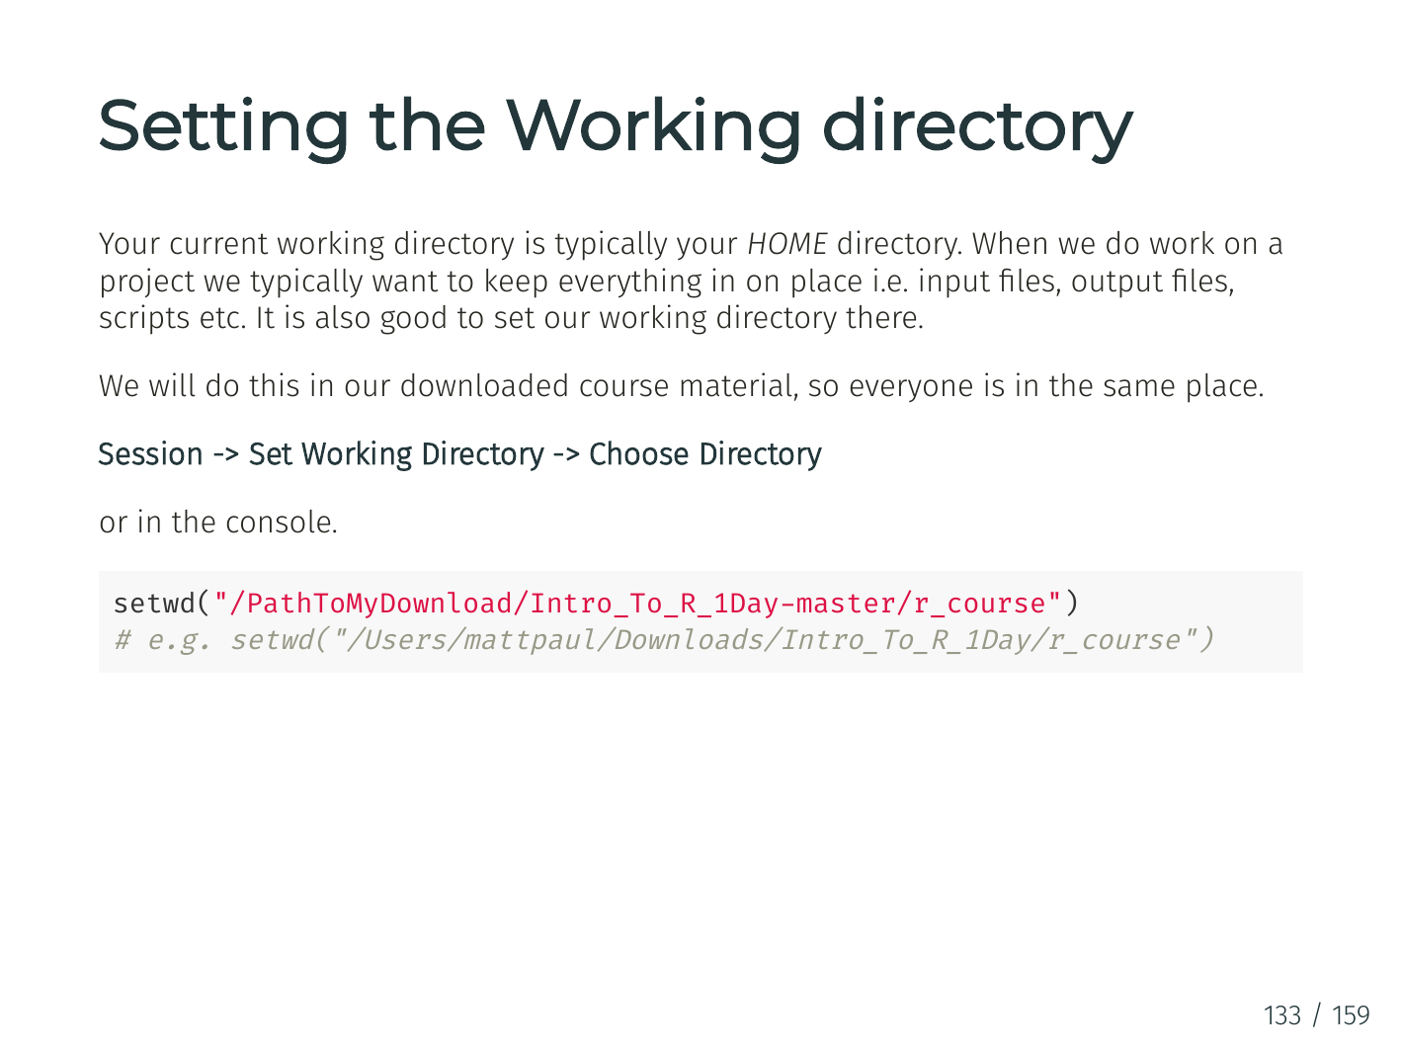

Slide 8
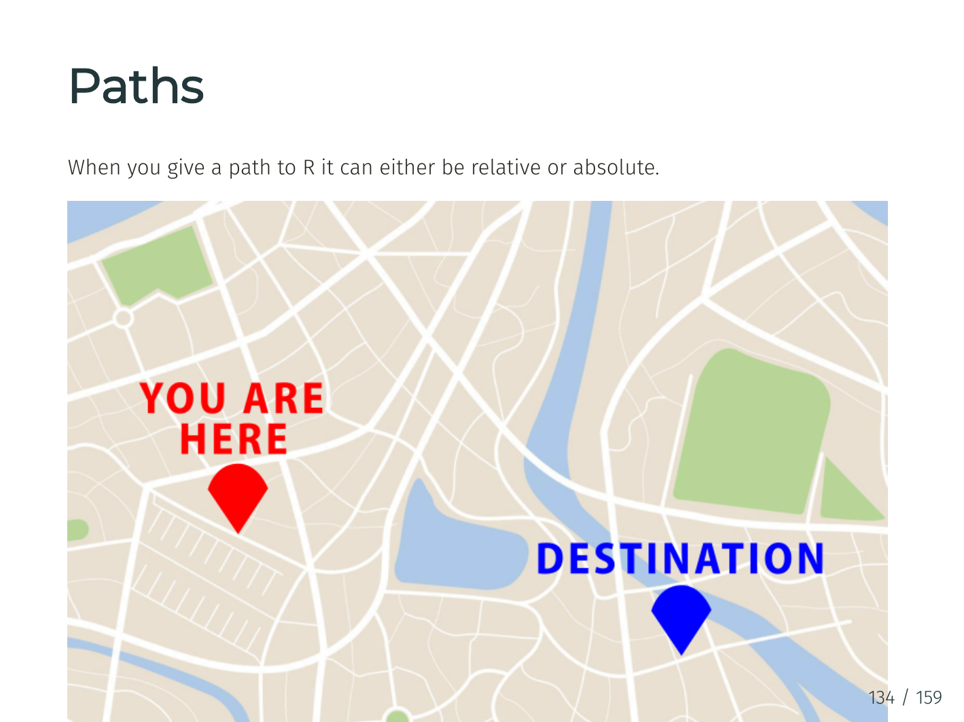

Slide 9
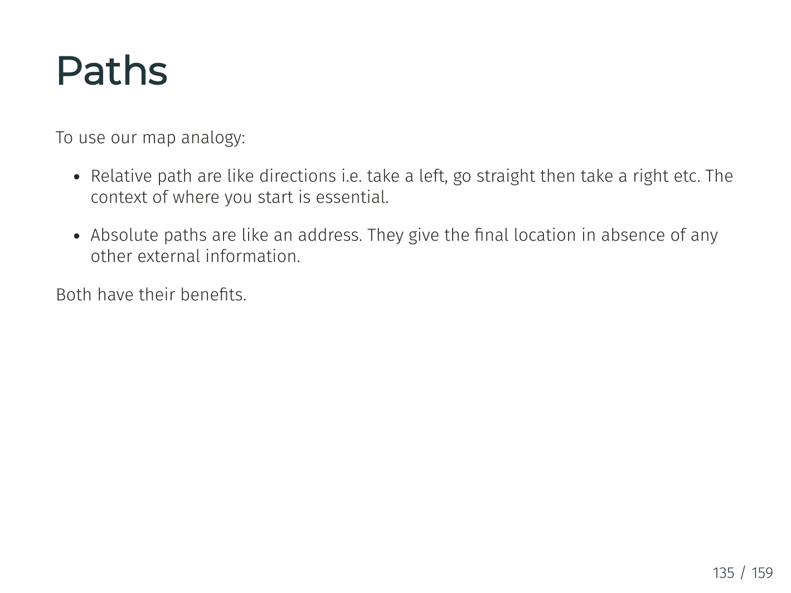

Slide 10
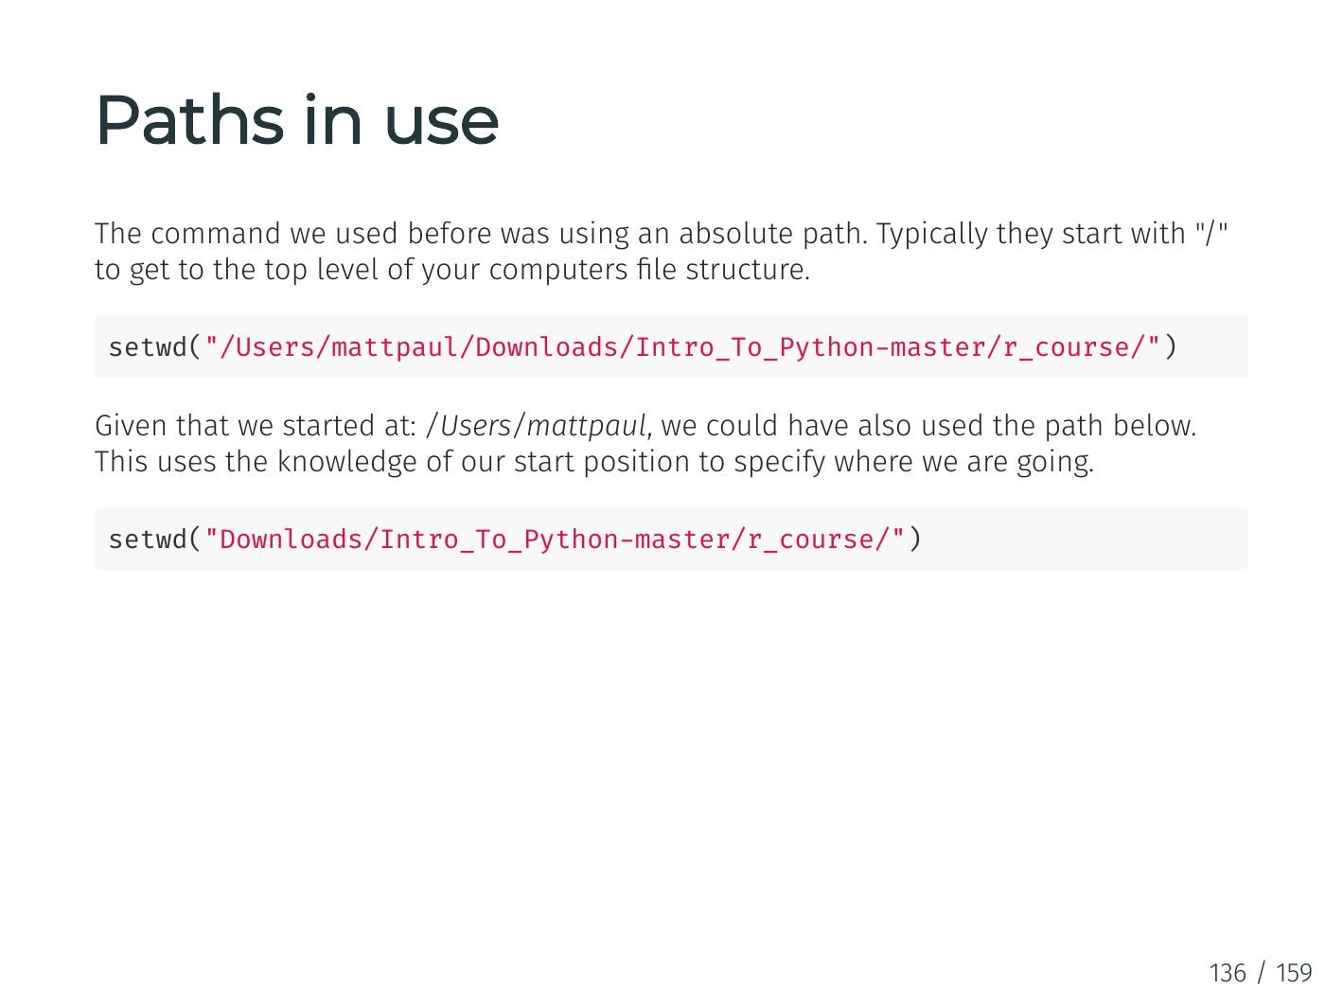

Slide 11
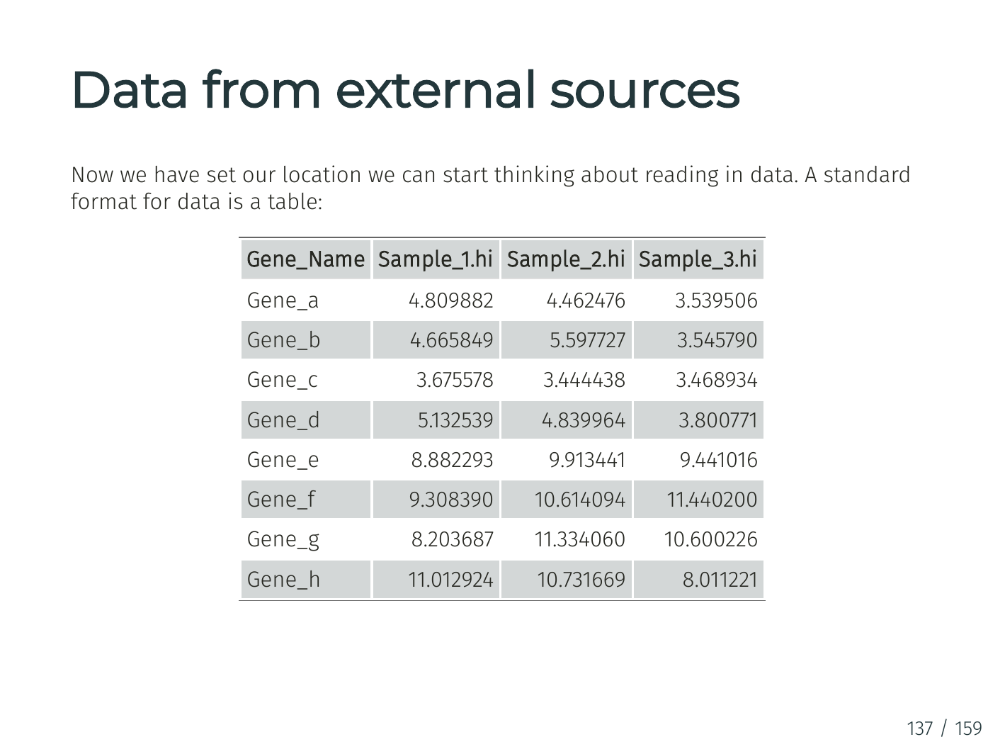

Slide 12
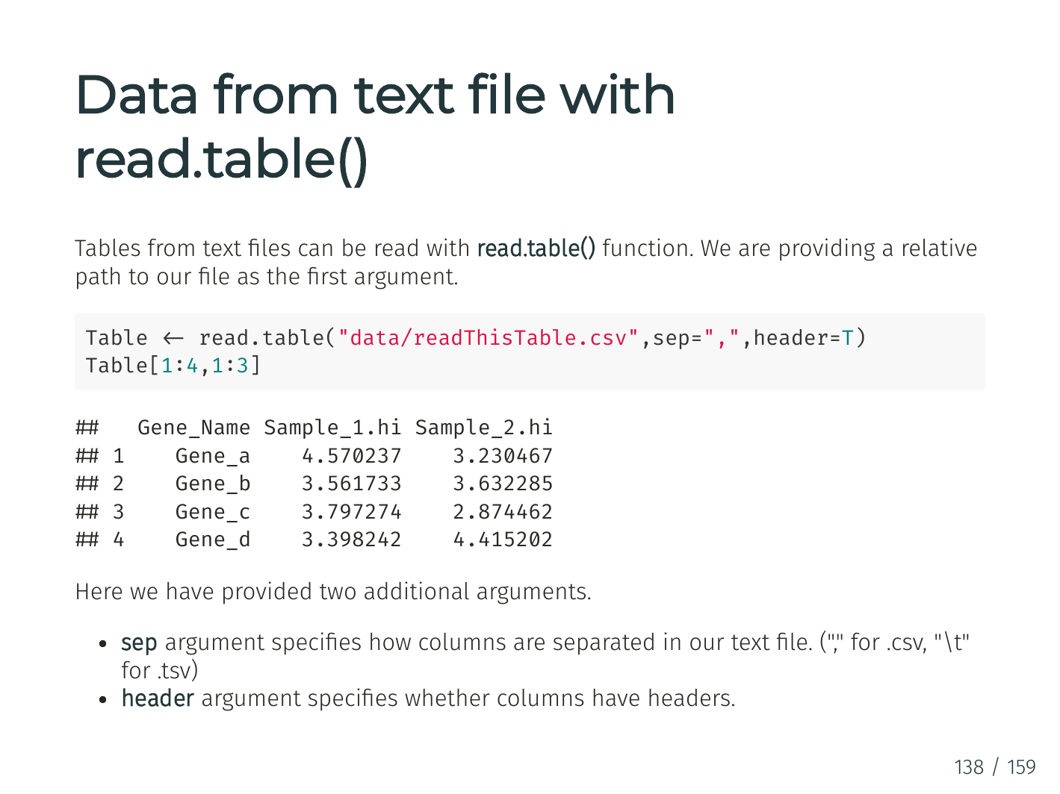

Slide 13
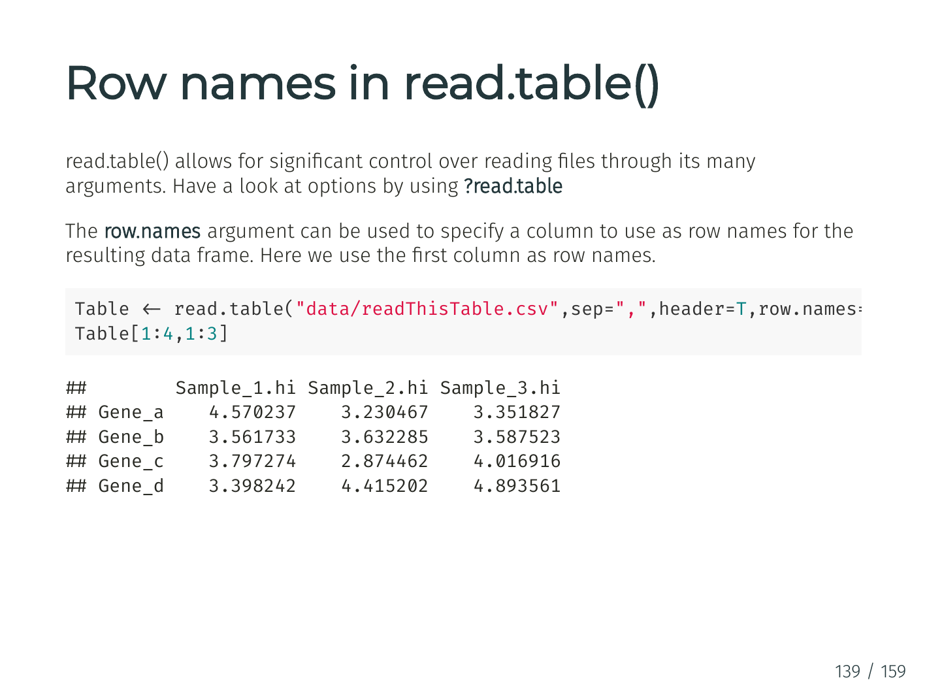

Slide 14
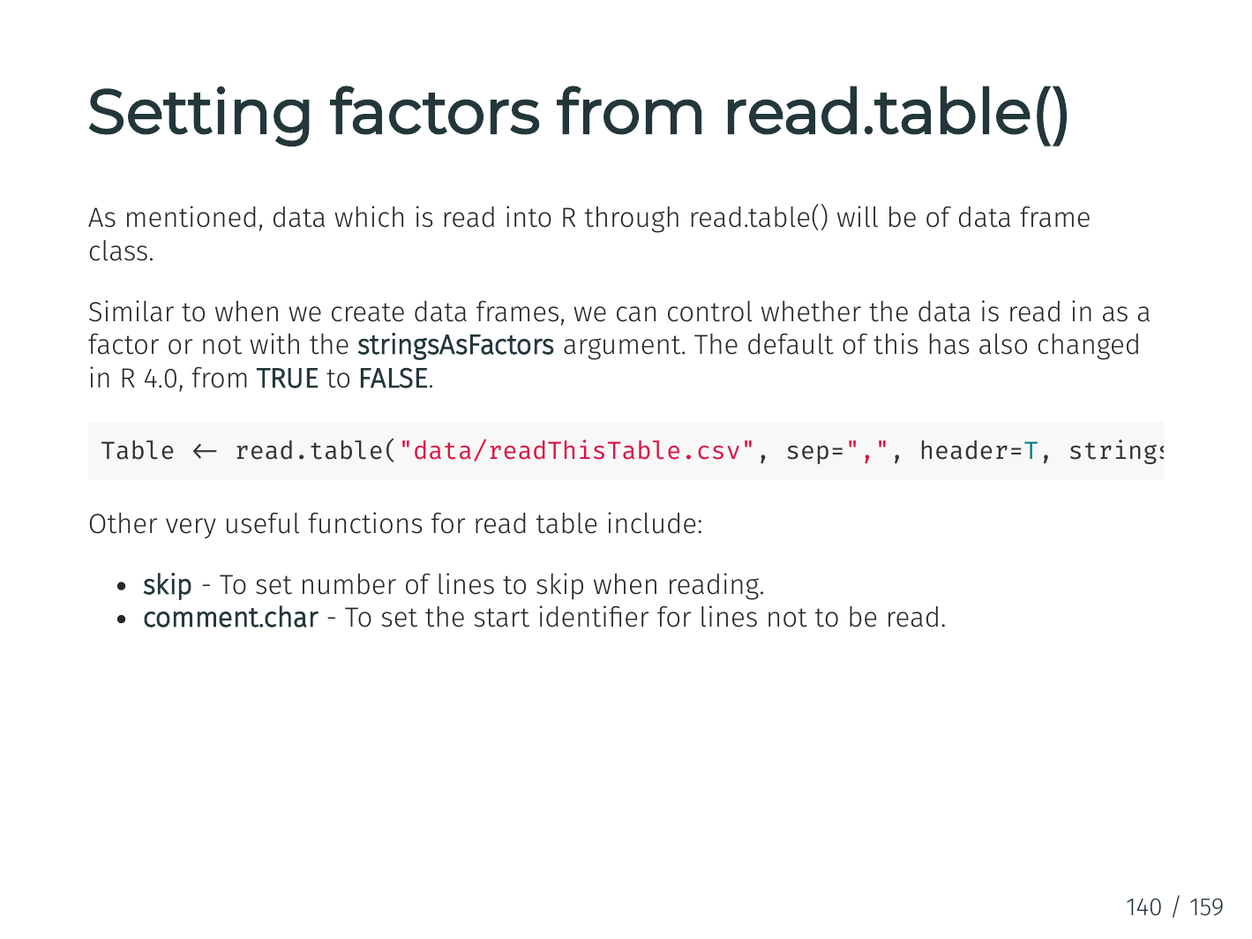

Slide 15
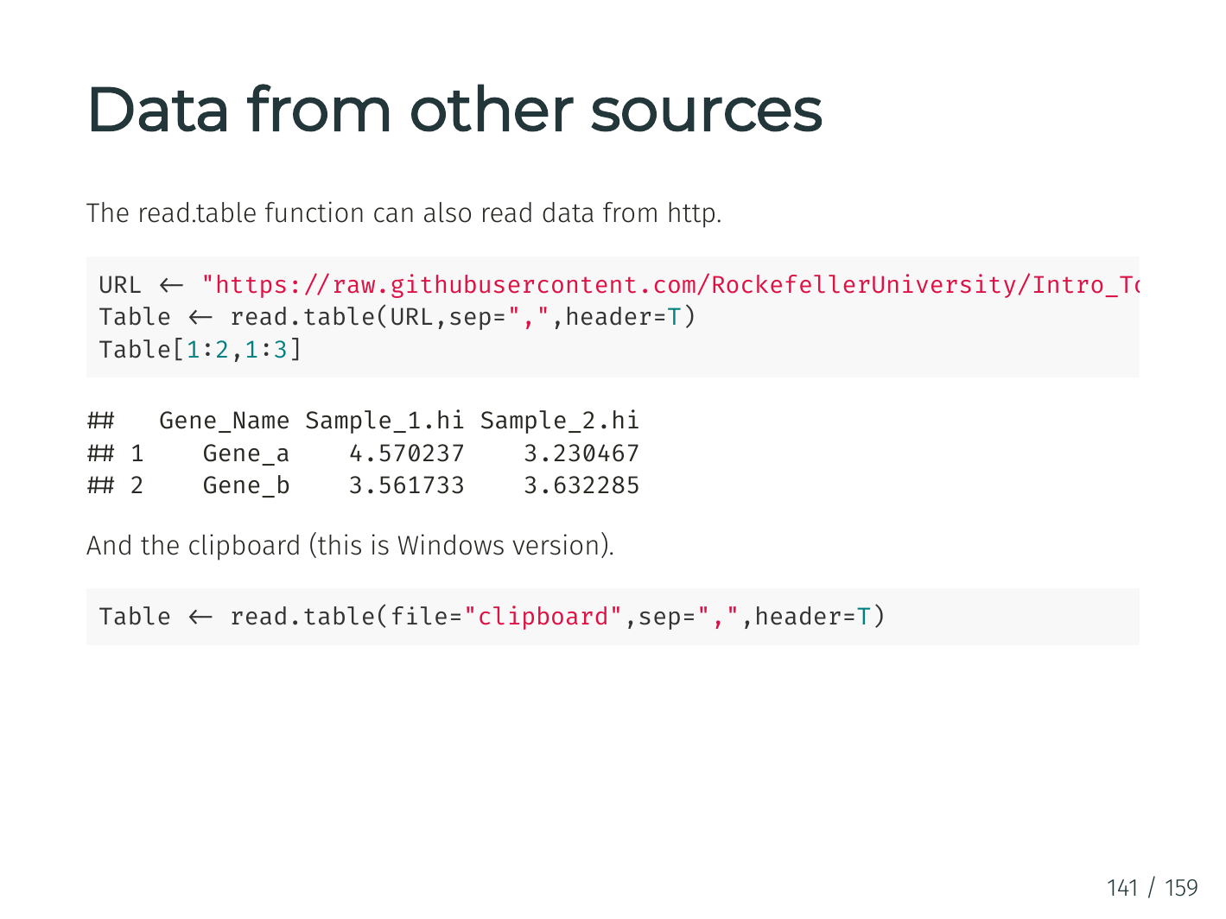

Slide 16
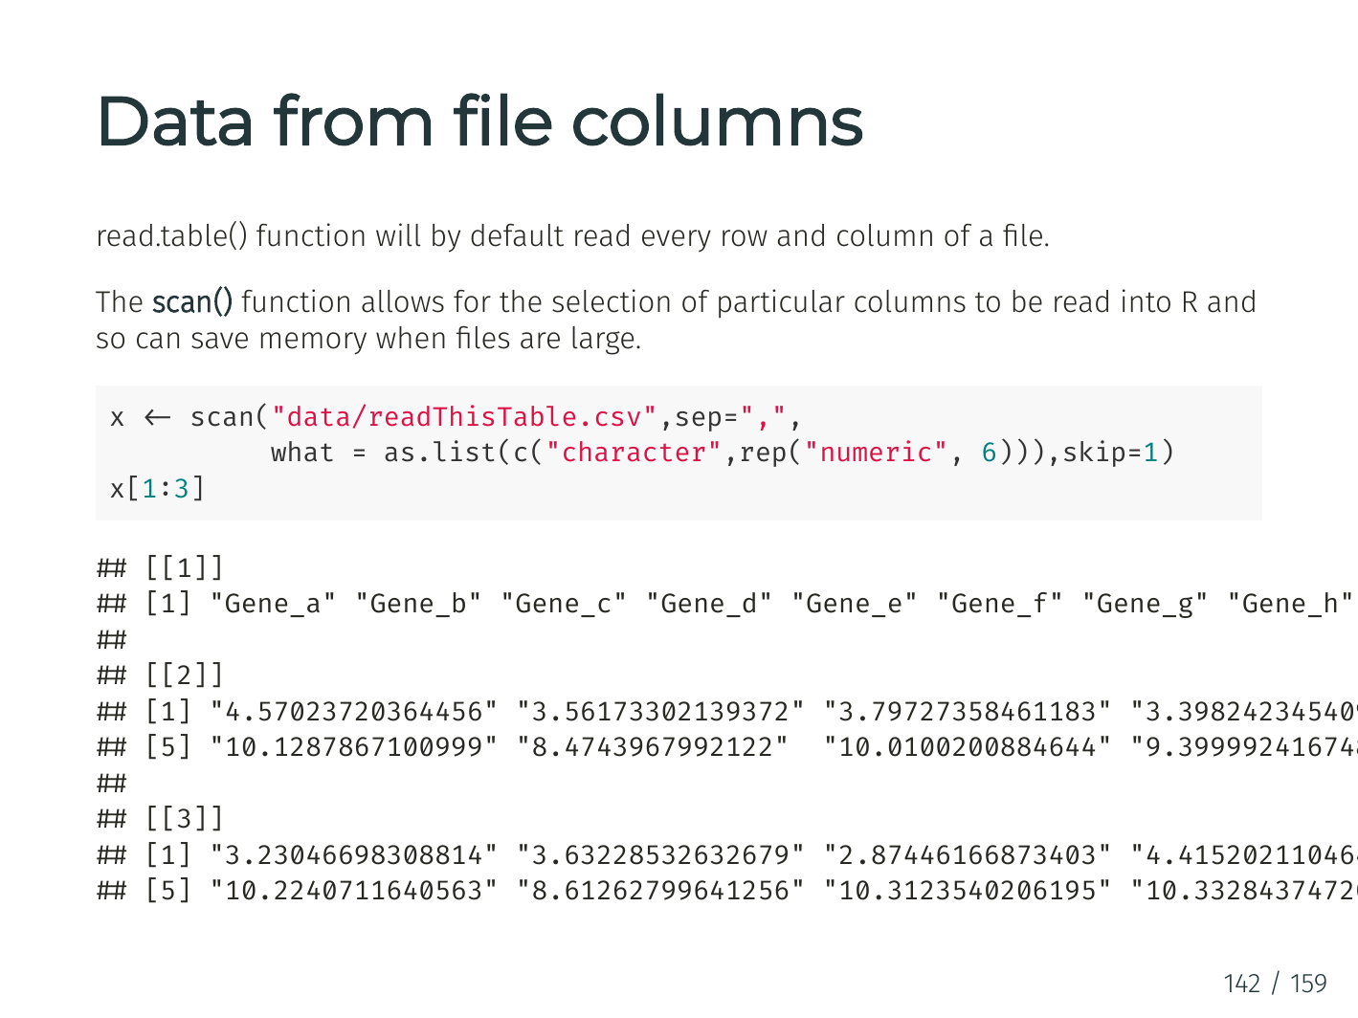

Slide 17
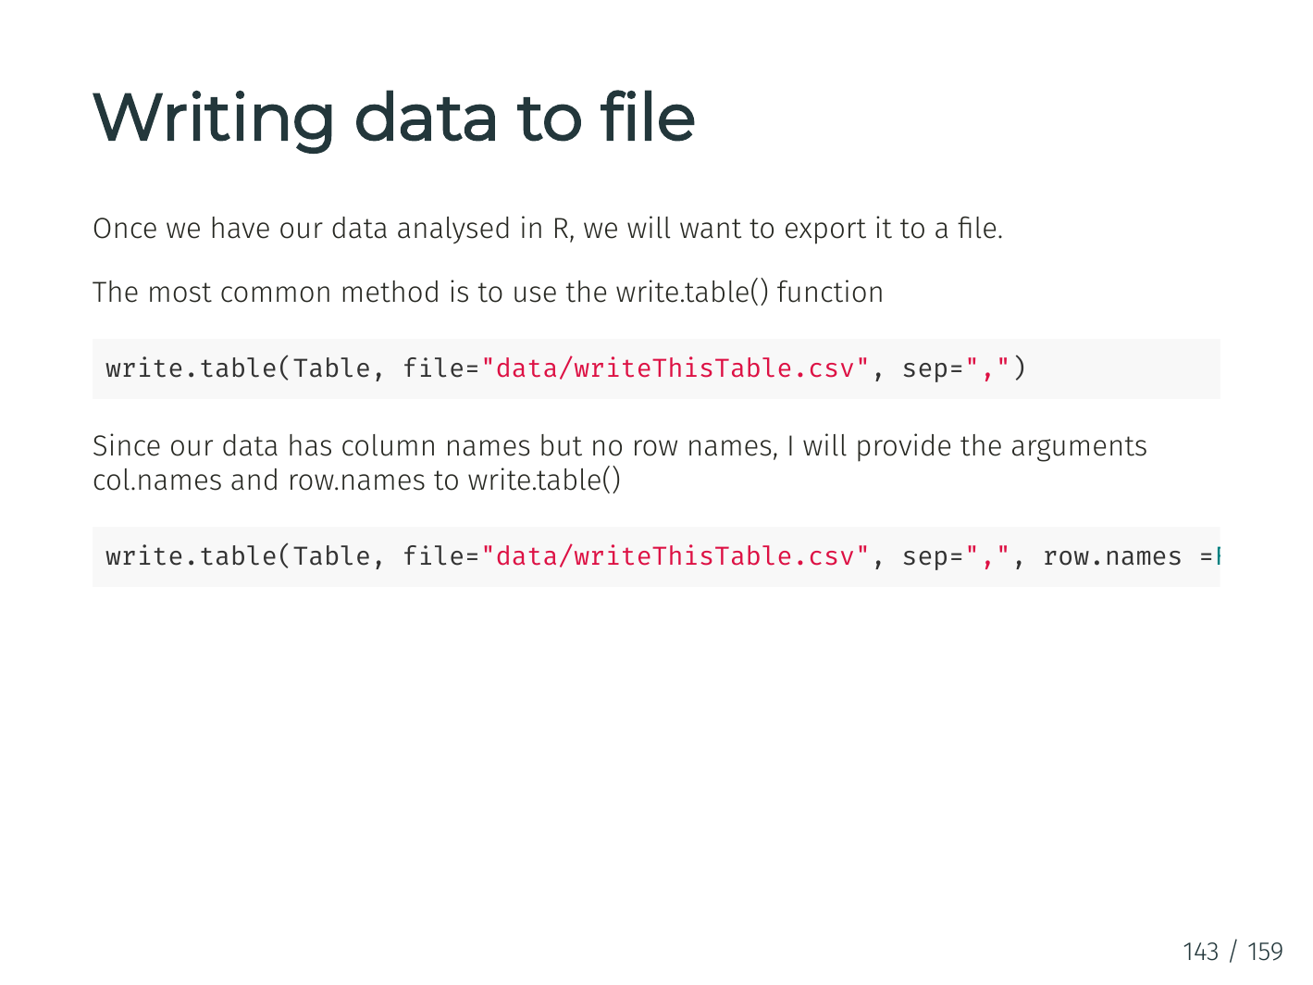

Slide 18
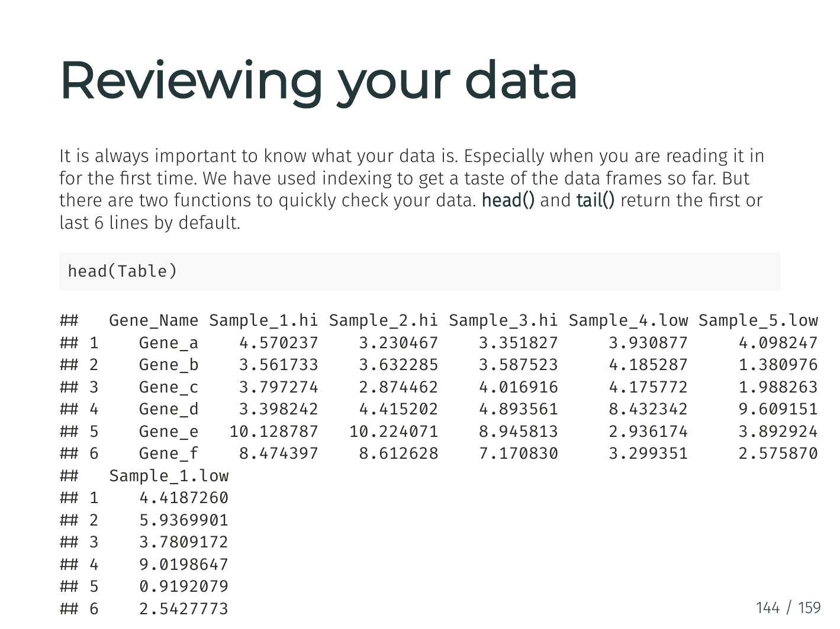

Slide 19
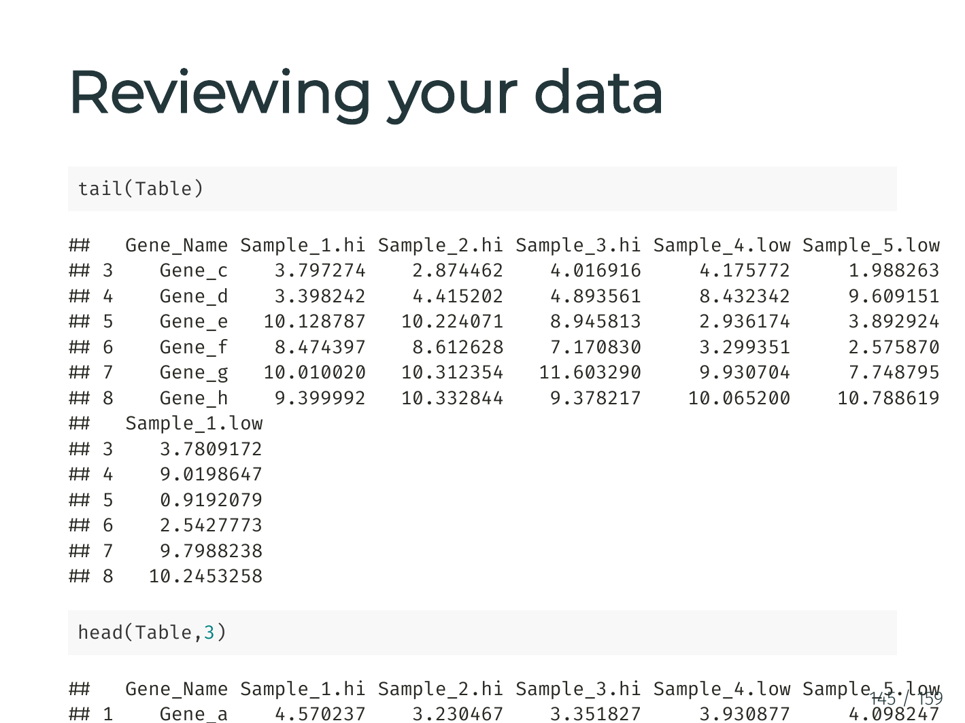

Slide 20
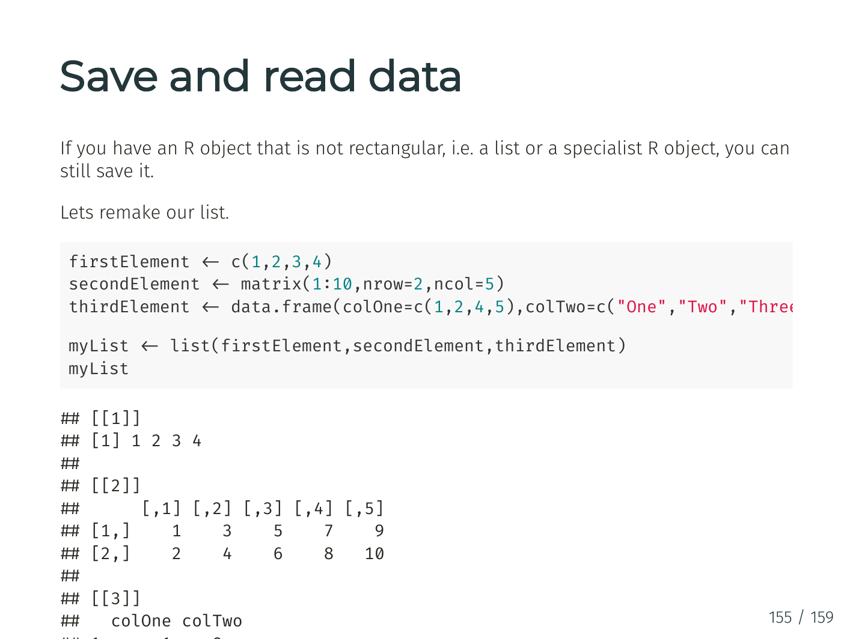

Slide 21
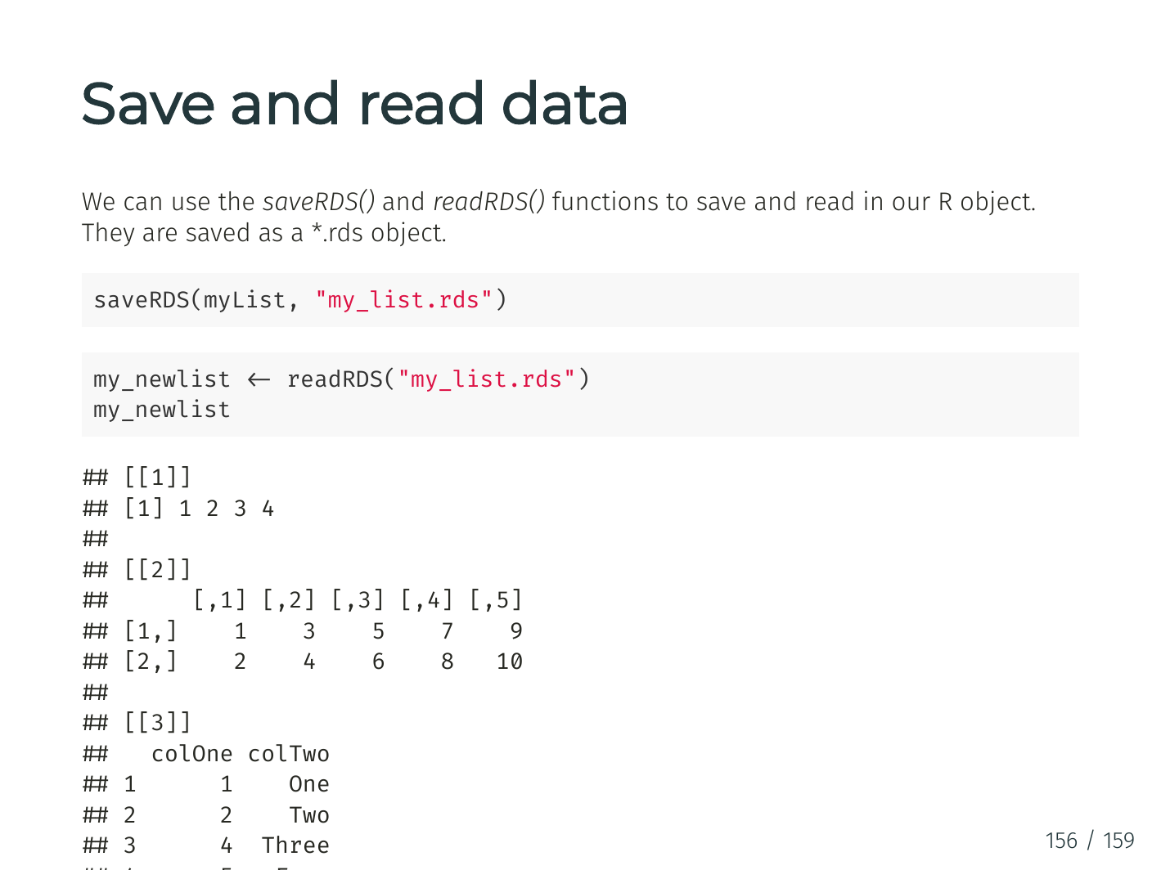

Slide 22
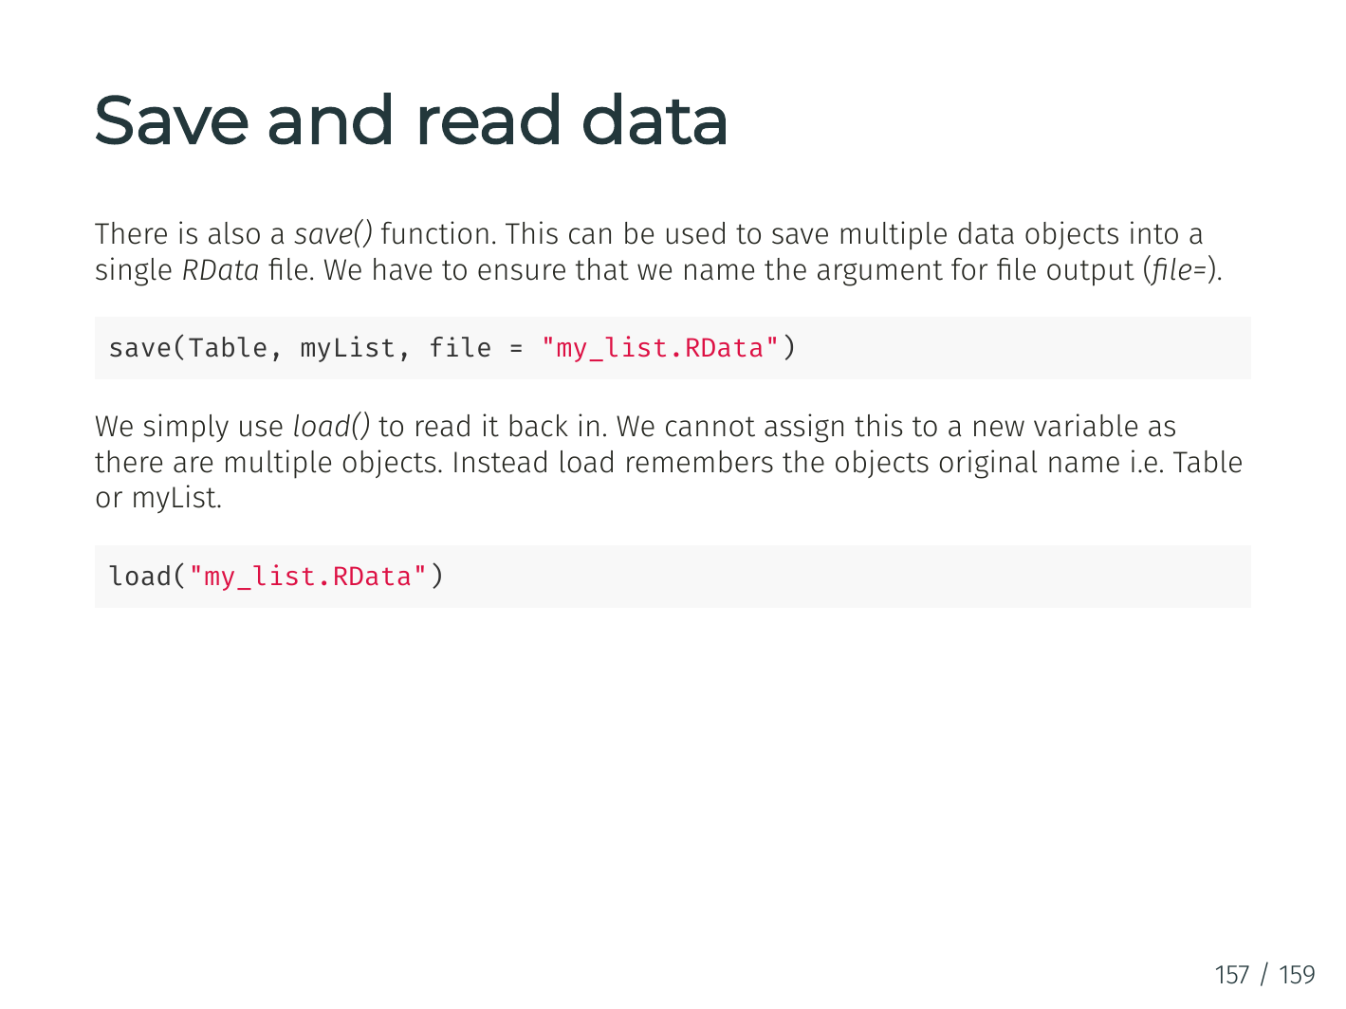

Slide 23
“I spend more than half of my time integrating, cleansing and transforming data without doing any actual analysis. Most of the time I’m lucky if I get to do any ‘analysis’ at all…
… Most of the time once you transform the data ... the insights can be scarily obvious.”

Slide 24
“Once you play with the data you realize you made an assumption that is completely wrong. It’s really useful, it’s not just a waste of time, even though you may be banging your head.”
“In practice it tends not to be just data prep, you are learning about the data at the same time, you are learning about what assumptions you can make.”

Slide 25

Data Wrangling
Aka Data Prep, Data Munging, Data Transformation
Assessing and transforming raw data to make it fit for use
That depends!
Fit for what use?

Slide 26
Data Wrangling
Aka Data Prep, Data Munging, Data Transformation
Assessing and transforming raw data to make it fit for use
This is how you “get your head in the game”
Understand what you have
Assess strengths and weaknesses of your data
Hypothesise about what to do with your data
Get it ready
Nobody will know your data as well as you do while wrangling
Not even the “you” of a few days later

Slide 27
Discussion
When is data “dirty”?
How does that happen?
Notes:
Many possibilities here for discussion
Outliers
Misspellings
Type/constraint violations
Inconsistencies
Duplication
Missing data
Unusual distributions
Wrong granularity
Wrong time or other scope
Data entry
Measurement error
Bad data integration
Poor experimental design
Mismatch of data to task

Slide 28
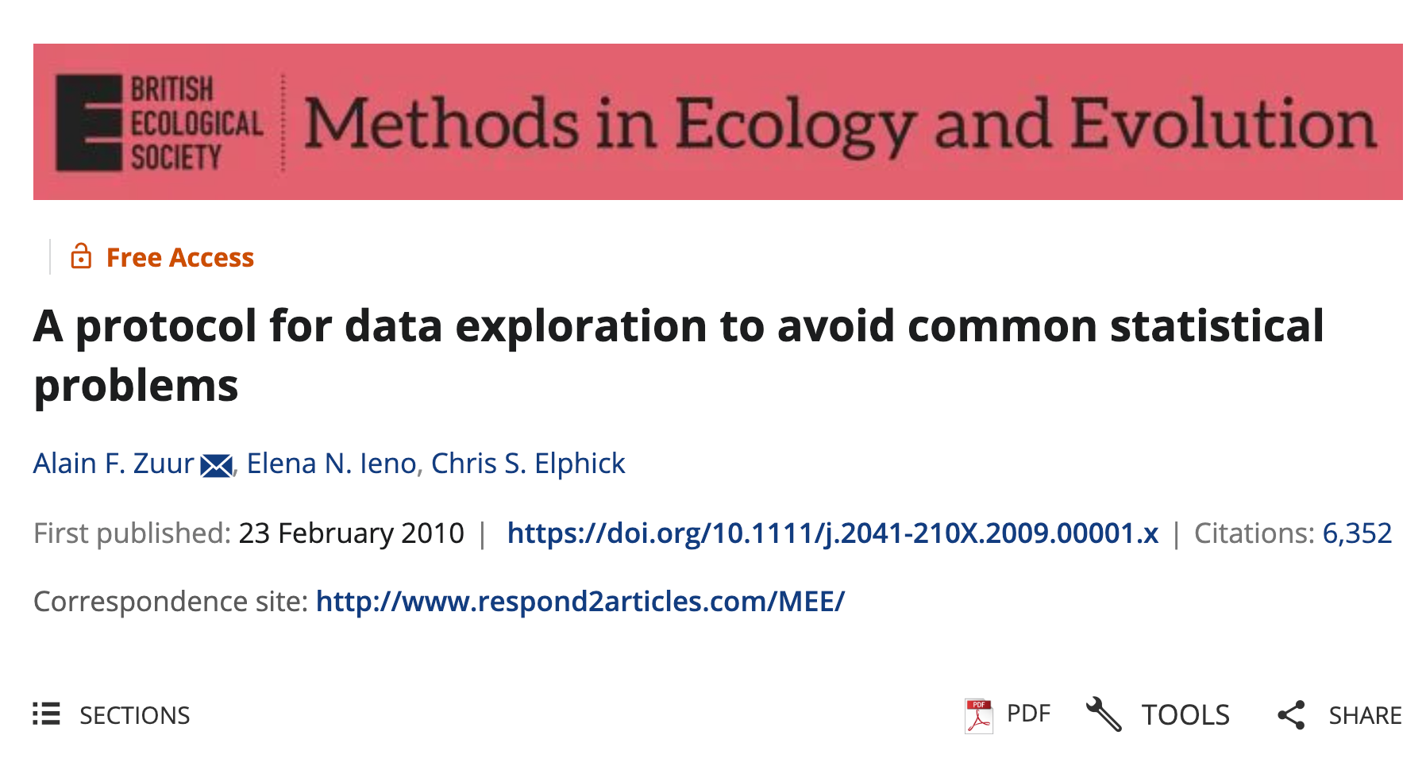
https://besjournals.onlinelibrary.wiley.com/doi/10.1111/j.2041-210X.2009.00001.x
Notes:
----- Meeting Notes (10/29/14 17:37) -----
FINISH ME!

Slide 30
Step 1 – Are There Outliers in Y or X?
Outliers are extreme values that differ from the rest of the data
They may arise from data entry errors, measurement errors, or real biological extremes
Outliers can skew visualisations, violate model assumptions, and bias results
"Outliers can dominate model outcomes or visualizations. Identifying them is essential before analysis.” - Zuur et al. (2010)

Slide 31
Step 1 – Are There Outliers in Y or X?
How would we look for outliers?
pacman::p_load(palmerpenguins, dplyr)
# Boxplot to detect outliers
boxplot(penguins$body_mass_g,
main = "Outlier Check: Body Mass (g)",
col = "lightgrey")
# Histogram to see distribution
hist(penguins$body_mass_g,
main = "Histogram of Body Mass (g)",
col = "skyblue")
Tip: Combine with summary() or sort()
to see extremes numerically.

Slide 32
Step 2 – Is the Variance Similar Across Groups?
Homogeneity means groups have a similar spread (variance).
Unequal variance can affect models like ANOVA or regression.
Can be visualized by comparing group distributions.
"Even moderate variance differences can degrade model reliability." — Zuur et al. (2010)

Slide 33
Step 2 in R – Check Variance (penguins)
How would we look for outliers?
# Compare body mass variance across species
boxplot(body_mass_g ~ species, data = penguins,
main = "Body Mass by Species",
col = c("lightblue", "lightgreen", "salmon"))
# Numerical check of variances
penguins %>%
group_by(species) %>%
summarise(var_mass = var(body_mass_g, na.rm = TRUE))

Slide 34
Step 3 – Are the Data Normally Distributed?
Normality refers to the bell-shaped curve in data distribution.
Histograms and QQ plots are used to inspect this.
Not all methods require normality, but it's important to check.
🗣 "Many methods are robust, but checking normality helps you choose the right approach." — Zuur et al. (2010)

Slide 35
Step 3 – Check Normality (penguins)
# Histogram of flipper length
hist(penguins$flipper_length_mm,
main = "Flipper Length Distribution",
col = "lightsteelblue")
# QQ plot (optional)
qqnorm(penguins$flipper_length_mm)
qqline(penguins$flipper_length_mm)
Tip: Look for symmetry and smooth tails in histograms.

Slide 36
Step 4 – Are There Lots of Zeros?
Excess zeros can distort models for count or binary data.
May require special modeling approaches.
Check both counts and joint absences (multivariate).
🗣 "Zero inflation requires special models or interpretation techniques." — Zuur et al. (2010)

Slide 37
Step 4 –Check Zeros (penguins)
# Create a binary variable
penguins$heavy <- ifelse(penguins$body_mass_g > 4500, 1, 0)
# Check frequency of 0s and 1s
table(penguins$heavy)
# Visualize
barplot(table(penguins$heavy),
main = "Binary Variable: Heavy (>4500g)",
col = "gold")

Slide 38
Step 5 – Are the Predictors Too Similar?
Collinearity occurs when two or more predictors are strongly correlated.
This can inflate standard errors and mask variable importance
Use correlation matrices or visual tools to detect it.
"Collinearity reduces model interpretability and power.” — Zuur et al. (2010)

Slide 39
Step 5 in R – Check Collinearity (penguins)
# Prepare numerical data
num_vars <- penguins %>%
select(bill_length_mm, bill_depth_mm, flipper_length_mm, body_mass_g) %>%
filter(if_all(everything(), ~ !is.na(.)))
# Correlation matrix
cor(num_vars)
# Visualise correlation
pacman::p_load(corrplot)
corrplot(cor(num_vars), method = "circle")

Slide 40
Step 6 – What Is the Relationship Between Y & X?
Helps identify if a linear model is appropriate, or if relationships are nonlinear.
Can reveal thresholds, curvatures, or outliers.
Always plot your response variable vs. each predictor.
"Scatterplots can reveal patterns that inform model design."— Zuur et al. (2010)

Slide 41
Step 6 in R – Plot Y vs. X (penguins)
# Base R scatterplot
plot(flipper_length_mm ~ body_mass_g,
data = penguins,
main = "Flipper Length vs. Body Mass",
col = "darkblue", pch = 19)

Slide 42



A basic R project set up
Week_2
Week_2.Rproj
Data
Quarto (.qmd)
Script
Lecture_script.R
Output
Plots
Lecture

Slide 43
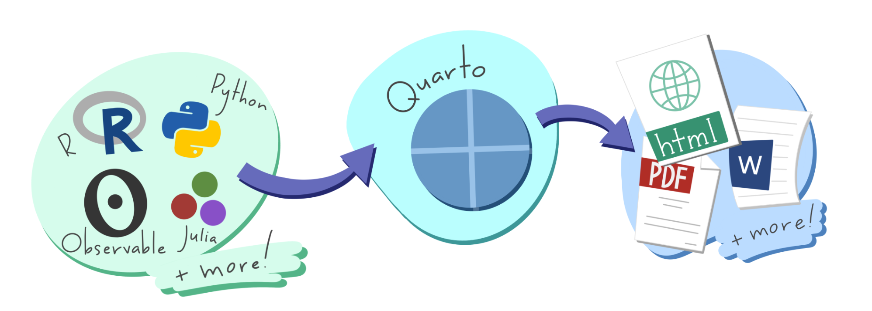

What is Quarto?
An open-source tool that seamlessly integrates code, results, and narrative text into a single document
Key Features:
Multi-language Support: Works with R, Python, Julia, and more.
Versatile Outputs: Generate reports, presentations, websites, and dashboards in formats like HTML, PDF, and Word.
Reproducibility: Ensures that analyses are transparent and reproducible by embedding code and its output directly within the document
Use Cases:
Communication: Present findings to stakeholders with clear narratives and visualisations.
Collaboration: Share comprehensive analyses with peers, including code and results.
Documentation: Maintain a detailed record of data analysis processes and decisions.
Integration:
Fully compatible with RStudio and other IDEs, providing a user-friendly interface for creating and rendering documents.

Slide 44
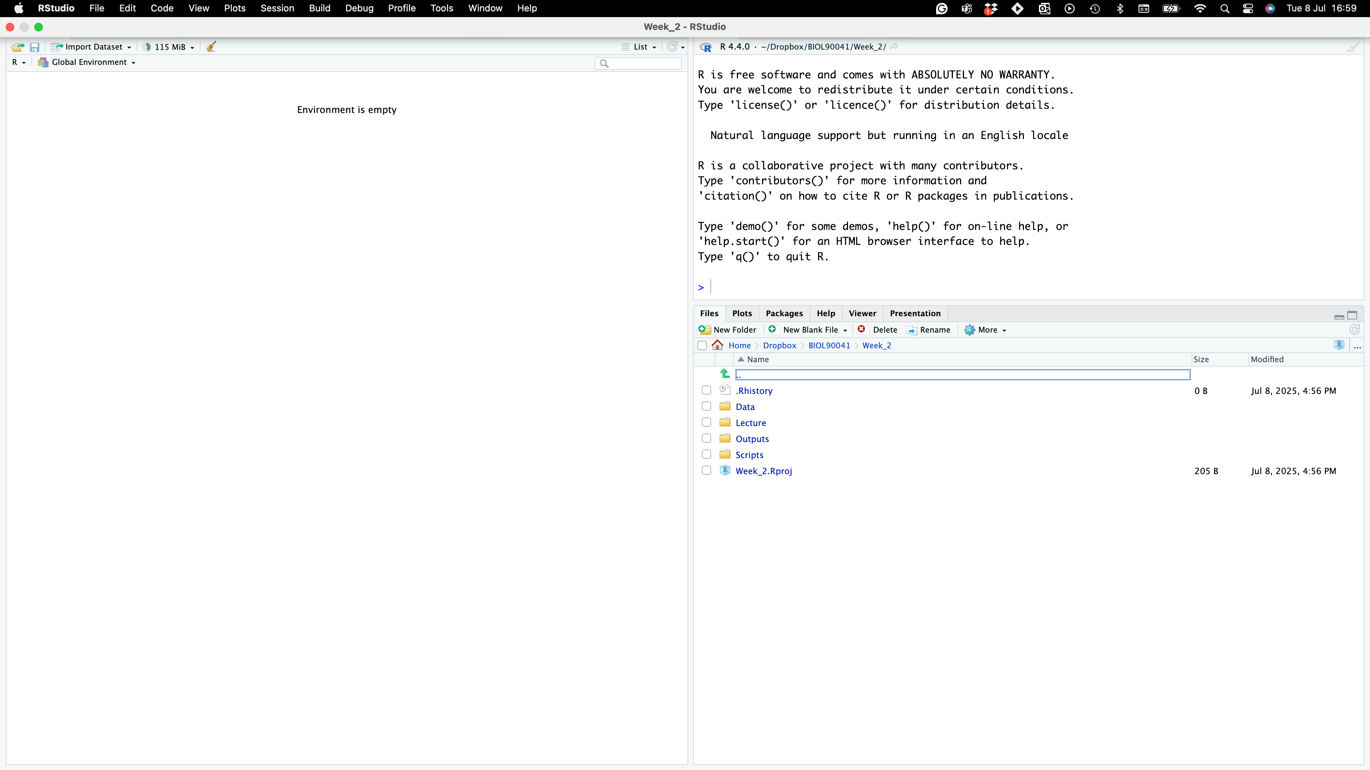
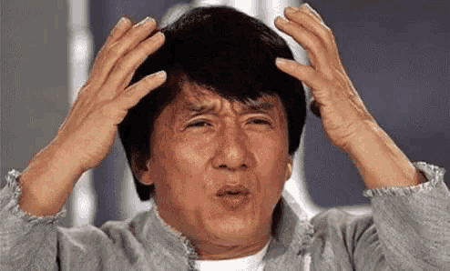
Where to find it?
Project name
NO SCRIPT?!?!!
Project folders

Slide 45
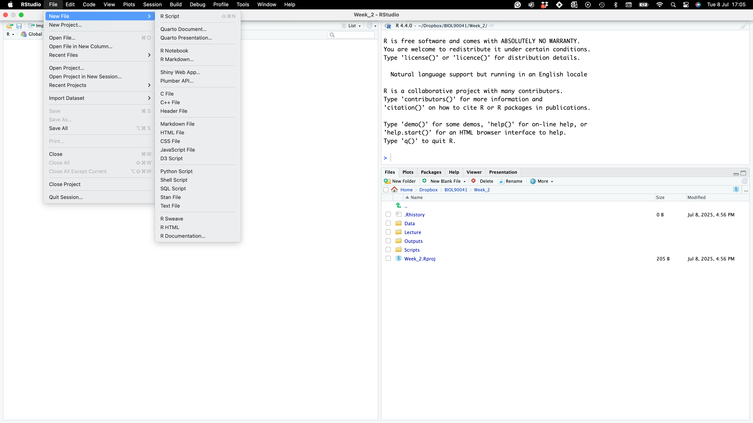
Where to find it?
NO SCRIPT?!?!!

Slide 46
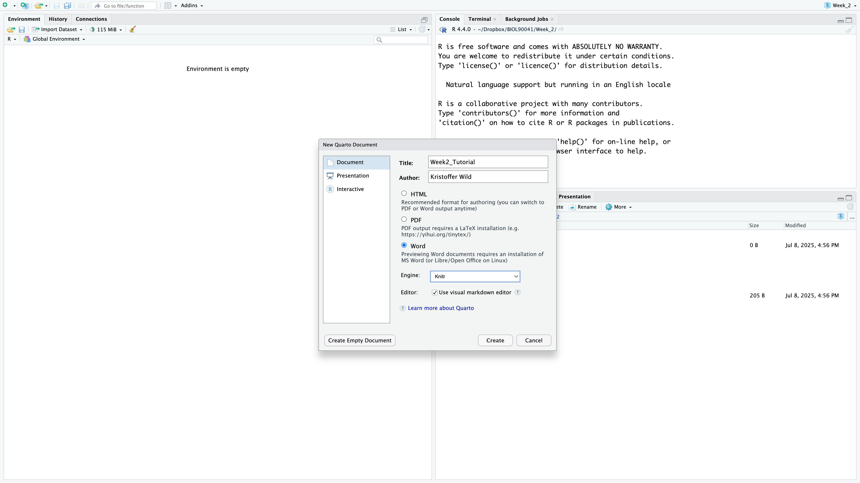
Where to find it?
NO SCRIPT?!?!!

Slide 47
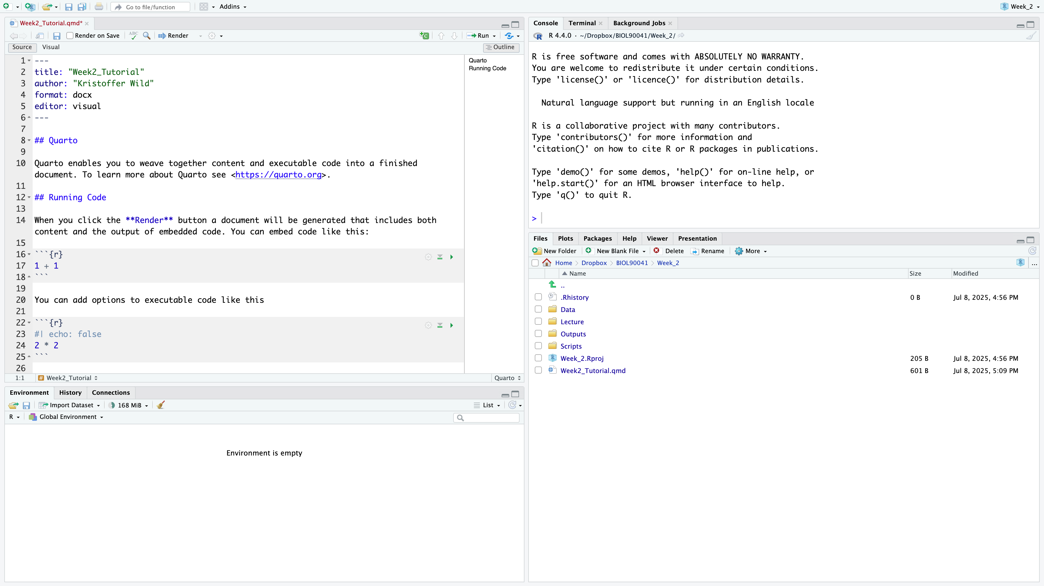
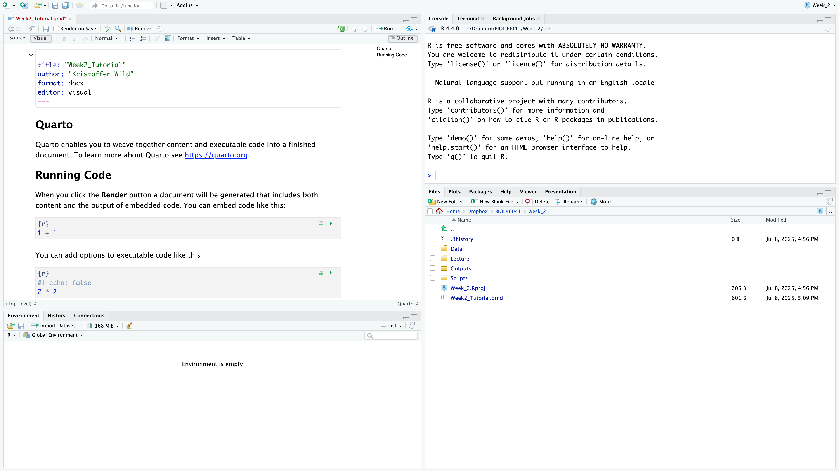
Where to find it?
Metadata
LINE #’s
NO SCRIPT?!?!!
Notes:
I saved my file as ‘Week2_tutorial.qmd’, for those of you that are use to markdown notice that the suffix has changed (rmd to qmd).
At the top of the document you will have some metadata on the document: title, format (word doc), editor….
The editor is a pretty awesome feature that you wouldn’t get in a markdown document. Here you can get the look of
what it would look like in a word document.

Slide 48
Where to find it?
Text
Text headings
Code ‘Chunks’
NO SCRIPT?!?!!
Notes:
I saved my file as ‘Week2_tutorial.qmd’, for those of you that are use to markdown notice that the suffix has changed (rmd to qmd).
At the top of the document you will have some metadata on the document: title, format (word doc), editor….
The editor is a pretty awesome feature that you wouldn’t get in a markdown document. Here you can get the look of
what it would look like in a word document.

Slide 49
Where to find it?
Check out the tool bar : change text formatting and see how source code changes!
NO SCRIPT?!?!!
Notes:
Now play with the tool bar
you can bold, italicize text
you can add in links
Change the formatting headings
If you go back to the source code you can see what it’s doing under the hood.
Here if you used markdown in the past, you would have to know this laytext code

Slide 50
Quarto live DEMO with Kris
Here we will go over…
setting up metadata to render into a word document
formatting code chunks
how code should be in code chunks
practicing writing results under code chunks
rendering document with appropriate code, plots, and write up

Slide 51
Class activity:
Q1. Create a vector that records the shoe sizes of 10 people in class
Q2. calculate the mean, median, sd, var, IQR
Q3. Create a histogram of the data. Is it skewed. Can you change the bin sizes of the histogramm
(Hint: ?hist)
Use other resources
Q4. Extra: separate your data into male and female show sizes and repeat 1-3 for the split data sets.

